Slide 1
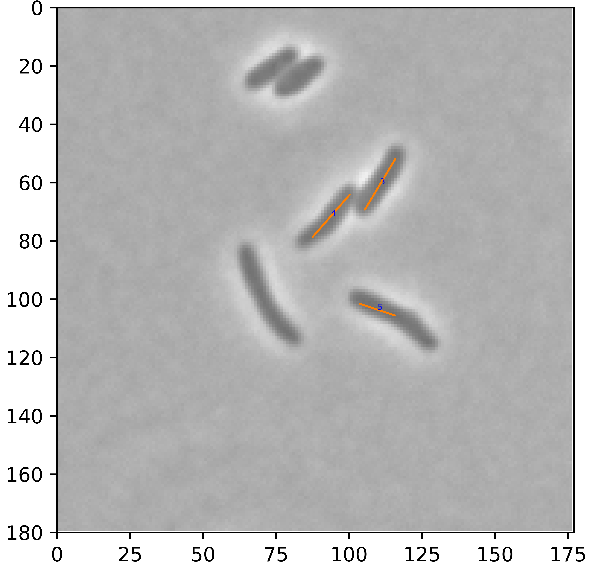
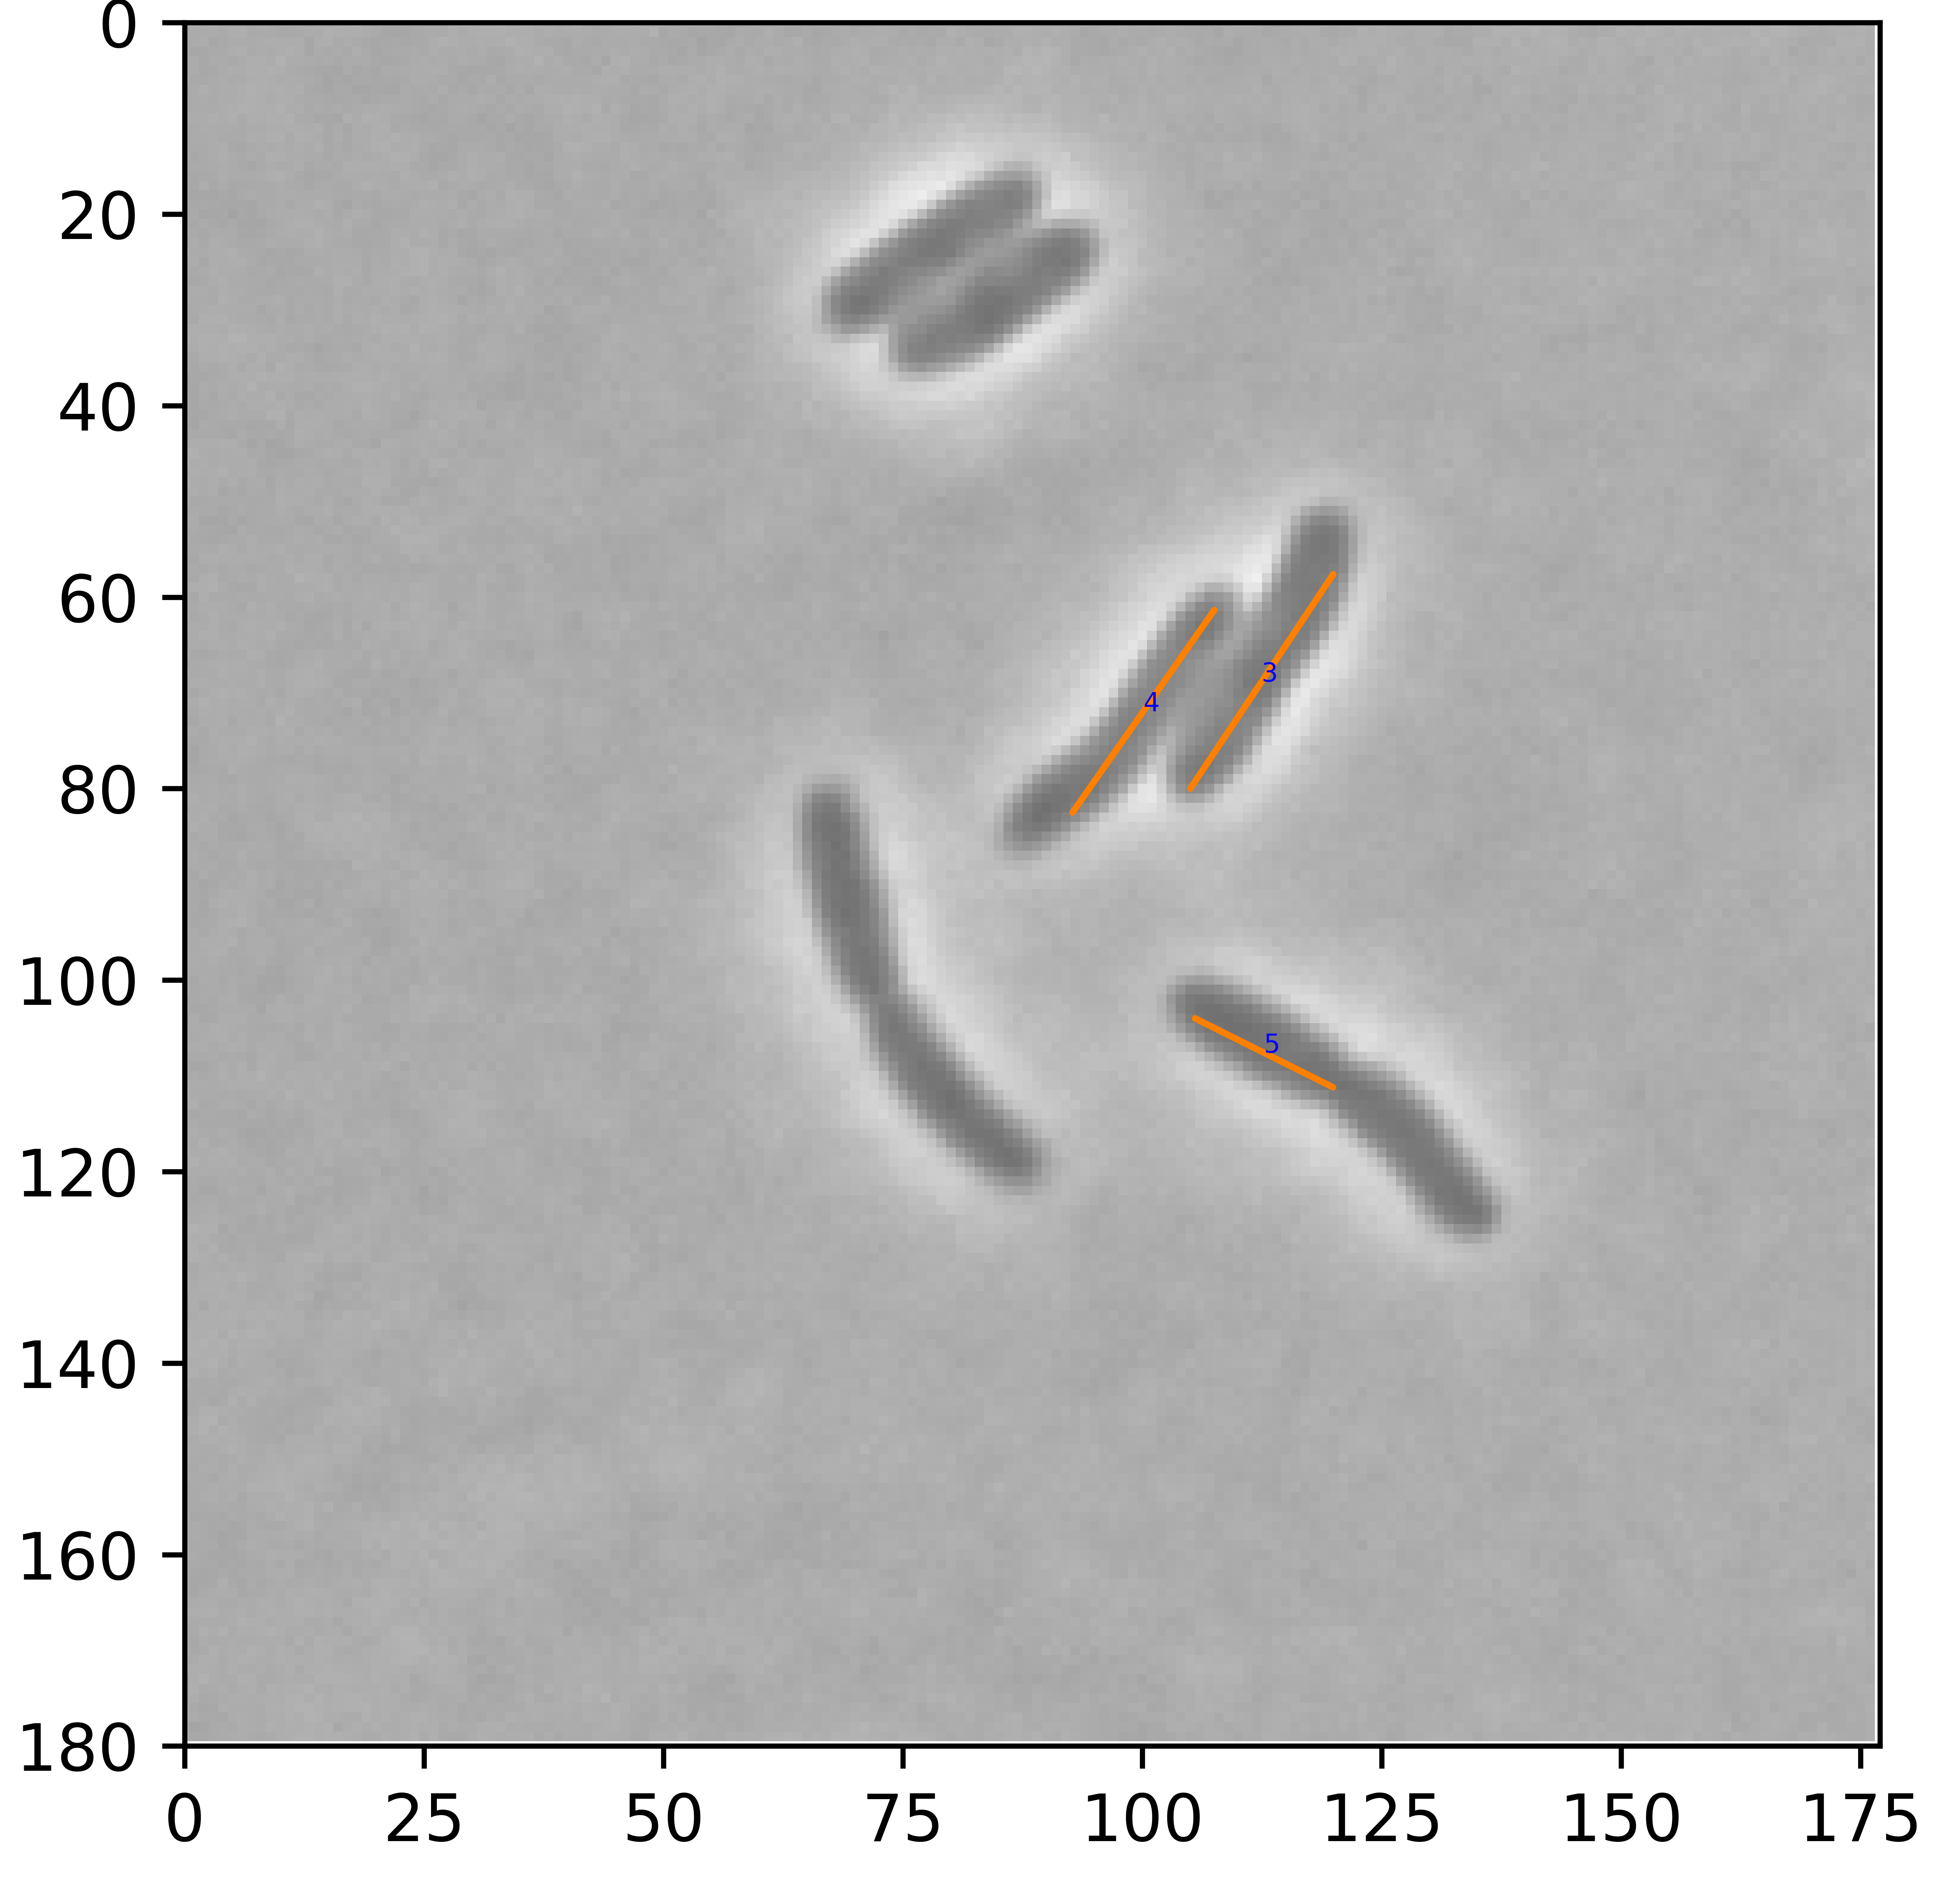
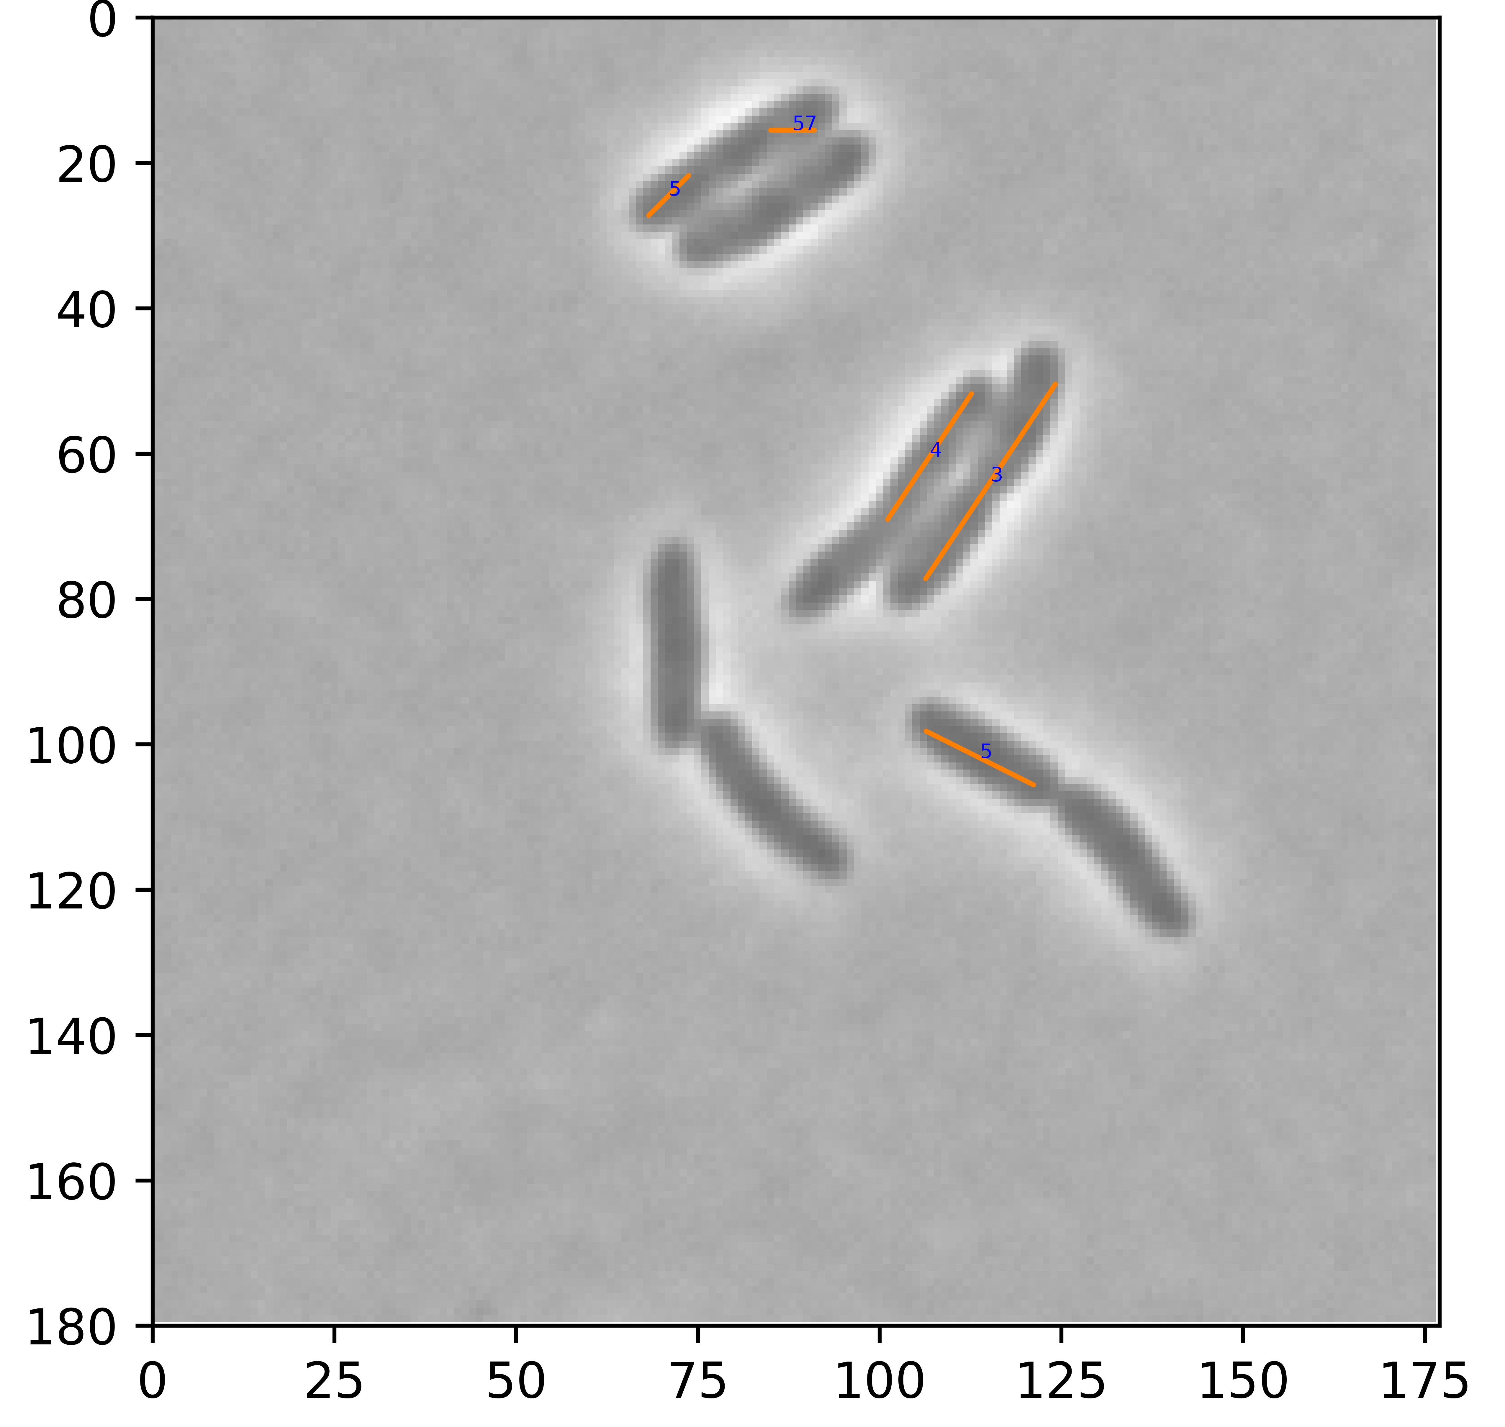
Label:57
Label: 5
Label: 4
Label: 4
Label: 4
Label: 3
Label: 3
Label: 5
Label: 5
Label: 5
t=0
t=15(min)
t=30(min)

